Slide 1
06: ARRAY

Slide 2
Introduction
Array: variable that can store a collection of data of the same type
  Examples: A list of names, A list of temperatures
Why do we need arrays?
  Imagine keeping track of 5 test scores, or 100, or 1000 in memory
    How would you name all the variables?
    How would you process each of the variables?

Slide 3
Declaring an Array
An array, named test, containing five variables of type int can be declared as
  int tests[5];
The value in brackets is called
  A subscript
  An index

Slide 4
Array - Memory Layout
The definition:
  int tests[5];
allocates the following memory:
first element | second element | third element | fourth element | fifth element

Slide 5
Array Terminology
In the definition int tests[5];
int is the data type of the array elements
tests is the name of the array
5, in [5], is the size declarator. It shows the number of elements in the array.
The size of an array is (number of elements) * (size of each element)

Slide 6
Array Terminology
The size of an array is:
  the total number of bytes allocated for it
  (number of elements) * (number of bytes for each element)
Examples:
  int tests[5] is an array of 20 bytes, assuming 4 bytes for an int
  long double measures[10]is an array of 80 bytes, assuming 8 bytes for a long double

Slide 7
Size Declarators
Named constants are commonly used as size declarators.
const int SIZE = 5;
int tests[SIZE];
This eases program maintenance when the size of the array needs to be changed.

Slide 8
Accessing Array Elements
Each element in an array is assigned a unique subscript.
Subscripts start at 0
subscripts:
0 | 1 | 2 | 3 | 4

Slide 9
Accessing Array Elements
The last element’s subscript is n-1 where n is the number of elements in the array.
subscripts:
0 | 1 | 2 | 3 | 4

Slide 10
Accessing Array Elements
Array elements can be used as regular variables:
  tests[0] = 79;
  cout << tests[0];
  cin >> tests[1];
  tests[4] = tests[0] + tests[1];
Arrays must be accessed via individual elements:
  cout << tests; // not legal

Slide 11
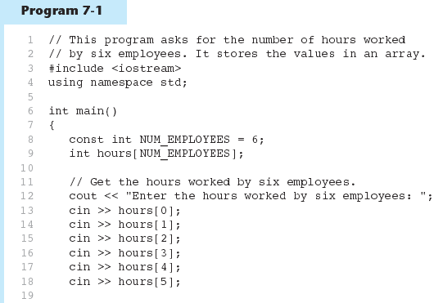
Accessing Array Elements - example
(Program Continues)

Slide 12
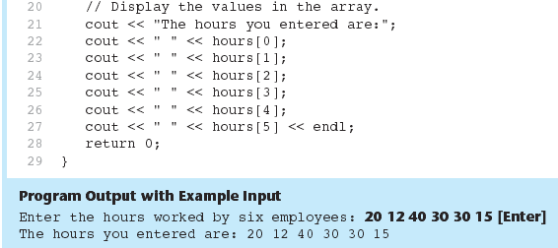
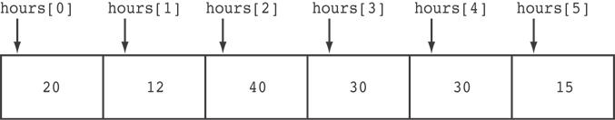
Accessing Array Elements - example
Here are the contents of the hours array, with the values entered by the user in the example output:

Slide 13
Accessing Array Contents
Can access element with a constant or literal subscript:
  cout << tests[3] << endl;
Can use integer expression as subscript:
  int i = 5;
  cout << tests[i] << endl;

Slide 14
Using a Loop to Step Through an Array
Example – The following code defines an array, numbers, and assigns 99 to each element:
const int ARRAY_SIZE = 5;
int numbers[ARRAY_SIZE];
for (int count = 0; count < ARRAY_SIZE; count++)
numbers[count] = 99;

Slide 15
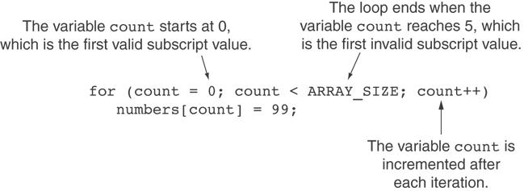
A Closer Look At the Loop

Slide 16
Default Initialization
Global array 🡪 all elements initialized to 0 by default
Local array 🡪 all elements uninitialized by default

Slide 17
No Bounds Checking in C++
When you use a value as an array subscript, C++ does not check it to make sure it is a valid subscript.
In other words, you can use subscripts that are beyond the bounds of the array.

Slide 18
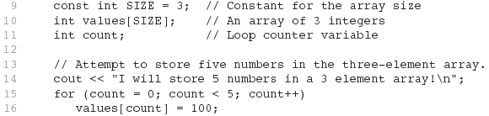
Example
The following code defines a three-element array, and then writes five values to it!

Slide 19
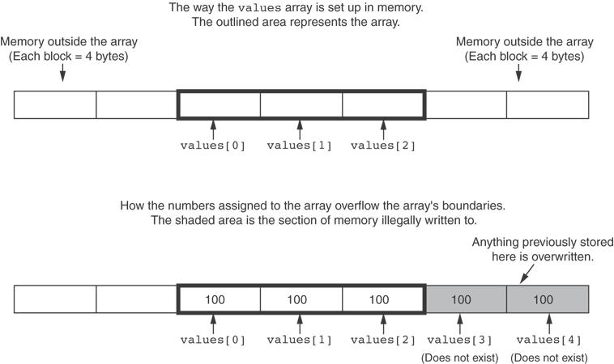
What the Code Does

Slide 20
No Bounds Checking in C++
Be careful not to use invalid subscripts.
Doing so can corrupt other memory locations, crash program, or lock up computer, and cause elusive bugs.

Slide 21
Array Initialization
Arrays can be initialized with an initialization list:
const int SIZE = 5;
int tests[SIZE] = {79,82,91,77,84};
The values are stored in the array in the order in which they appear in the list.
The initialization list cannot exceed the array size.

Slide 22
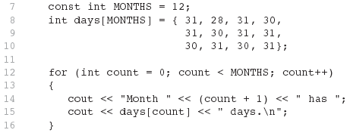
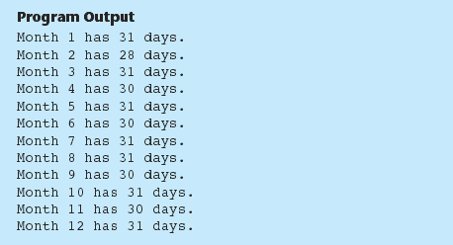
Example

Slide 23
Array Initialization
Valid
  int tests[3] = { 3, 5, 11 };
Invalid
  int tests[3] = {};
  tests= { 3, 5, 11 };

Slide 24
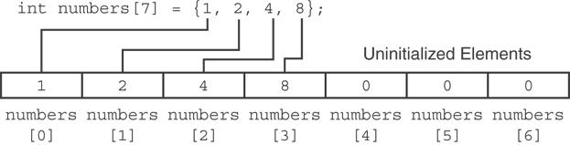
Partial Array Initialization
If array is initialized with fewer initial values than the size declarator, the remaining elements will be set to 0:

Slide 25
Implicit Array Sizing
Can determine array size by the size of the initialization list:
  int quizzes[]={12,17,15,11};
Must use either array size declarator or initialization list at array definition
12 | 17 | 15 | 11

Slide 26
Initializing With a String
Character array can be initialized by enclosing string in " ":
  const int SIZE = 6;
  char fName[SIZE] = "Henry";
Must leave room for \0 at end of array
If initializing character-by-character, must add in \0 explicitly:
  char fName[SIZE] =
  { 'H', 'e', 'n', 'r', 'y', '\0'};

Slide 27
In-Class Exercise
Are each of the following valid or invalid array definitions? (If a definition is invalid, explain why)
int numbers[l0] = {0, 0, 1, 0, 0, 1, 0, 0, 1, 1};
int matrix[5] = {1, 2, 3, 4, 5, 6, 7};
double radix[10] = {3.2, 4.7};
int table[7] = {2, , ,27, ,45,39};
char codes [] = {‘A', 'X', '1', '2', 's'};
int blanks[]; int blanks[5]; // int blanks[] = {};
char name[6] = "Joanne";

Slide 28
Processing Array Contents
Array elements can be treated as ordinary variables of the same type as the array
When using ++, -- operators, don’t confuse the element with the subscript:
  tests[i]++; // add 1 to tests[i]
  tests[i++]; // increment i, no
  // effect on tests

Slide 29
Array Assignment
To copy one array to another,
Don’t try to assign one array to the other:
  newTests = tests; // Won't work
Instead, assign element-by-element:
  for (i = 0; i < ARRAY_SIZE; i++)
  newTests[i] = tests[i];

Slide 30
Printing the Contents of an Array
You can display the contents of a character array by sending its name to cout:
char fName[] = "Henry";
  cout << fName << endl;
  But, this ONLY works with character arrays!

Slide 31
Printing the Contents of an Array
For other types of arrays, you must print element-by-element:
  for (i = 0; i < ARRAY_SIZE; i++)
  cout << tests[i] << endl;

Slide 32
Summing and Averaging Array Elements
Use a simple loop to add together array elements:
  int tnum;
  double average, sum = 0;
  for(tnum = 0; tnum < SIZE; tnum++)
  sum += tests[tnum];
Once summed, can compute average:
  average = sum / SIZE;

Slide 33
Finding the Highest Value in an Array
int count;
int highest;
highest = numbers[0];
for (count = 1; count < SIZE; count++)
{
if (numbers[count] > highest)
highest = numbers[count];
}
When this code is finished, the highest variable will contain the highest value in the numbers array.

Slide 34
Finding the Lowest Value in an Array
int count;
int lowest;
lowest = numbers[0];
for (count = 1; count < SIZE; count++)
{
if (numbers[count] < lowest)
lowest = numbers[count];
}
When this code is finished, the lowest variable will contain the lowest value in the numbers array.

Slide 35
Partially-Filled Arrays
If it is unknown how much data an array will be holding:
  Make the array large enough to hold the largest expected number of elements.
  Use a counter variable to keep track of the number of items stored in the array.

Slide 36
Comparing Arrays
To compare two arrays, you must compare element-by-element:
const int SIZE = 5;
int firstArray[SIZE] = { 5, 10, 15, 20, 25 };
int secondArray[SIZE] = { 5, 10, 15, 20, 25 };
bool arraysEqual = true; // Flag variable
int count = 0; // Loop counter variable
// Compare the two arrays.
while (arraysEqual && count < SIZE)
{
if (firstArray[count] != secondArray[count])
arraysEqual = false;
count++;
}
if (arraysEqual)
cout << "The arrays are equal.\n";
else
cout << "The arrays are not equal.\n";

Slide 37
In-Class Exercise
Given the following array definition:
int values[] = {2,6,10,14};
What does each of the following display?
cout<<values[2];
cout<<++values[0];
cout<< values[1]++;
x = 2;
cout<<values[++x];

Slide 38
In-Class Exercise
Declare an integer array named names with 20 elements. Write a loop that prints each element of the array.

Slide 39
In-Class Exercise
Write a program that lets the user enter 10 values into an array. The program should then display the largest and smallest values stored in the array.
Write a program that lets the user enter the total rainfall for each of 12 months into an array of doubles. The program should then calculate and display the total rainfall for the year, the average monthly rainfall, and the months with the highest and lowest amounts.
Input Validation: Do not accept negative numbers for monthly rainfall figures.

Slide 40
Using Parallel Arrays
Parallel arrays: two or more arrays that contain related data
A subscript is used to relate arrays: elements at same subscript are related
Arrays may be of different types

Slide 41
Parallel Array Example
const int SIZE = 5; // Array size
int id[SIZE]; // student ID
double average[SIZE]; // course average
char grade[SIZE]; // course grade
...
for(int i = 0; i < SIZE; i++)
{
cout << "Student ID: " << id[i]
<< " average: " << average[i]
<< " grade: " << grade[i]
<< endl;
}

Slide 42
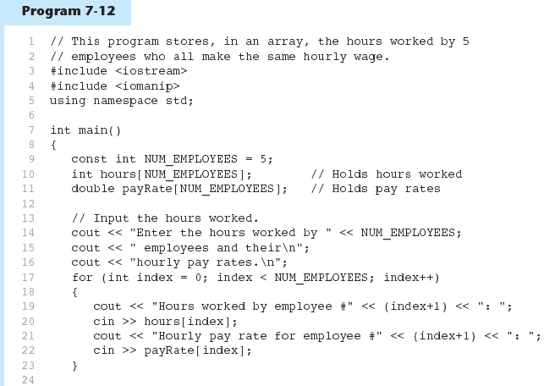
Parallel Array Example
(Program Continues)

Slide 43
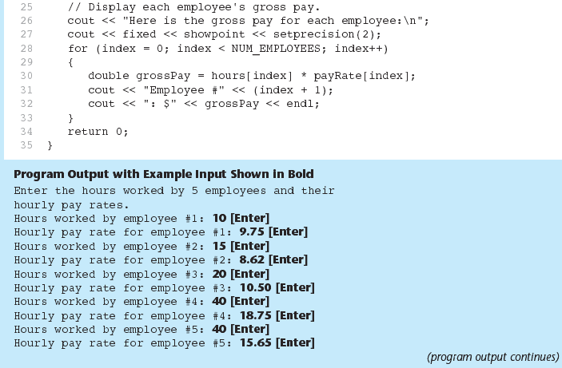
Parallel Array Example
Program 7-12 (Continued)

Slide 44
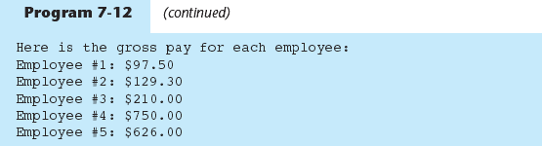
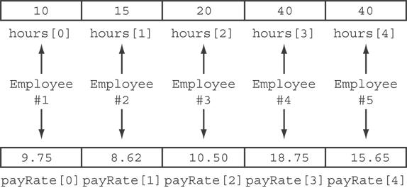
Parallel Array Example
The hours and payRate arrays are related through their subscripts:

Slide 45
In-Class Exercise
What is the output of the following code?
(You may need to use a calculator.) .
const int SIZE = 5;
int time[SIZE] = {1, 2, 3, 4, 5},
speed[SIZE] = {18, 4, 27, 52, 100},
dist[SIZE];
for (int count = 0; count < SIZE; count++)
dist[count] = time[count] * speed[count];
for (int count = 0; count < SIZE; count++) {
cout << time[count] << " ";
cout << speed[count] << " ";
cout « dist[count] << endl;
}

Slide 46
In-Class Exercise
Write a program that store the populations of 5 countries. Define 2 arrays that may be used in parallel to store the names of the countries and their populations. Write a loop that uses these arrays to print each country’s name and its population.

Slide 47
Arrays as Function Arguments
To pass an array to a function, just use the array name:
  showScores(tests);
To define a function that takes an array parameter, use empty [] for array argument:
  void showScores(int []); // function prototype
  void showScores(int tests[])// function header

Slide 48
Arrays as Function Arguments
When passing an array to a function, it is common to pass array size so that function knows how many elements to process:
  showScores(tests, ARRAY_SIZE);
Array size must also be reflected in prototype, header:
  void showScores(int [], int);
  // function prototype
  void showScores(int tests[], int size)
  // function header

Slide 49
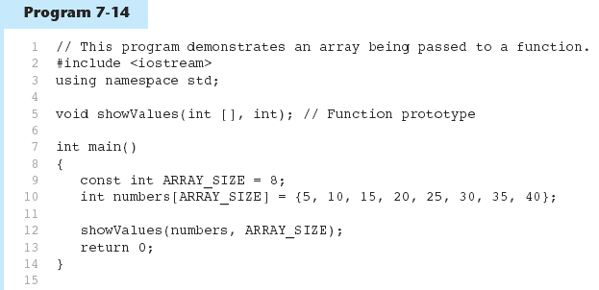
Arrays as Function Arguments - example
(Program Continues)

Slide 50
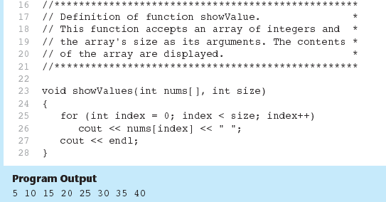
Arrays as Function Arguments - example
Program 7-14 (Continued)

Slide 51
Modifying Arrays in Functions
Array names in functions are like reference variables – changes made to array in a function are reflected in actual array in calling function
Need to exercise caution that array is not inadvertently changed by a function

Slide 52
In-Class Exercise
The following program skeleton, when completed, will ask the user to enter 10 integers which are stored in an array. The function avgArray, which you must write, is to calculate and return the average of the numbers entered.
#include <iostream>
//Write your function prototype here
int main() {
const int SIZE = 10;
int userNums[SIZE];
cout << "Enter 10 numbers: ";
for (int count = 0; count < SIZE; count++){
cout << "#" « (count + 1) << " ";
cin >> userNums[count];
}
cout << "The average of those numbers is ";
cout << avgArray(userNUms, SIZE) << endl;
return 0;
}
//Write the function avgArray here.

Slide 53
In-Class Exercise
#include <iostream>
using namespace std;
void Test(int []);
int main()
{
int myArr [4]={3,4,5,6};
for(int i=0;i<4;i++)
cout<<myArr[i]<<" ";
cout<<endl;
Test(myArr);
cout<<endl;
for(int i=0;i<4;i++)
cout<<myArr[i]<<" ";
system("pause");
return 0;}
void Test(int z[])
{
int temp=z[3];
z[3]=z[0];
z[0]=temp;
for(int j=0;j<4;j++)
cout<<z[j]<<" ";
}

Slide 54
In-Class Exercise
#include <iostream>
using namespace std;
void Test(int , int,int[]);
int main()
{ int x = 1;
int y[3];
y[0]=1;
Test(x,y[0],y);
cout<<"x is: " << x<< endl;
cout<<"y[0] is: " <<y[0] << endl;
for(int i=0;i<3;i++)
cout<<y[i]<<endl;
system("pause");
return 0;}
void Test(int num, int num1, int z[])
{
num=1001;
num1=290;
z[1]=34;
z[2]=35;
}

Slide 55
In-Class Exercise
Each of the following definitions and program segments has errors. Locate as many as you can and correct the errors.
void showValues(int nums)
{
    for(int i = 0; i<8; i++)
    cout<<nums[i];
    }
b) void showValues(int nums [4])
{
for(int i = 0; i<8; i++)
cout<<nums[i];
}

Slide 56
In-Class Exercise
Consider the following function prototypes:
void funcOne(int [], int);
int findSum(int, int);
And the declarations:
int list[50];
int num;
Write a C++ statements that:
Call the function funcOne with the actual parameters, list and 50 respectively.
Print the value returned by the function funcSum with the actual parameters, 50, and the fourth element of list respectively.
Print the value returned by the function funcSum with the actual parameters, the thirtieth and tenth elements of list, respectively.

Slide 57
In-Class Exercise
Write a program that has two overloaded functions that return the average of an array with the following headers:
int average(int array[], int size)
double average(int array[], int size
Use {1,2,3,4,5,6} and {6.0,4.4,1.9,2.9,3.4,3.5} to test the functions.

Slide 58
In-Class Exercise
Write a program that has a function that returns the index of the smallest element in an array of integers. If there are more than one such elements, return the smallest index. Use {1,2,4,5,10,100,2,-22} to test the function.

Slide 59
Two-Dimensional Arrays
Can define one array for multiple sets of data
Like a table in a spreadsheet
Use two size declarators in definition:
  const int ROWS = 4, COLS = 3;
  int exams[ROWS][COLS];
First declarator is number of rows; second is number of columns

Slide 60
Two-Dimensional Array Representation
const int ROWS = 4, COLS = 3;
int exams[ROWS][COLS];
Use two subscripts to access element:
  exams[2][2] = 86;
columns
exams[0][0] | exams[0][1] | exams[0][2]
exams[1][0] | exams[1][1] | exams[1][2]
exams[2][0] | exams[2][1] | exams[2][2]
exams[3][0] | exams[3][1] | exams[3][2]
r
o
w
s

Slide 61
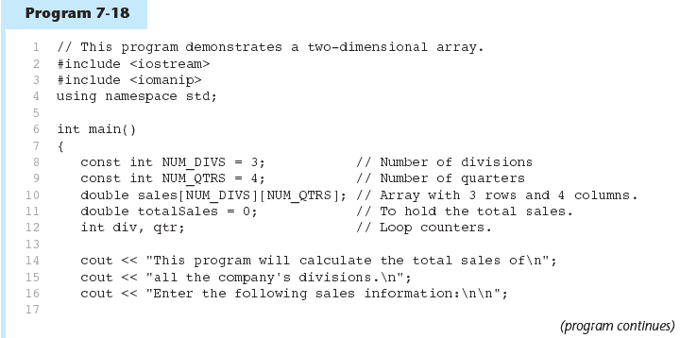
Two-Dimensional Array Representation - Example

Slide 62
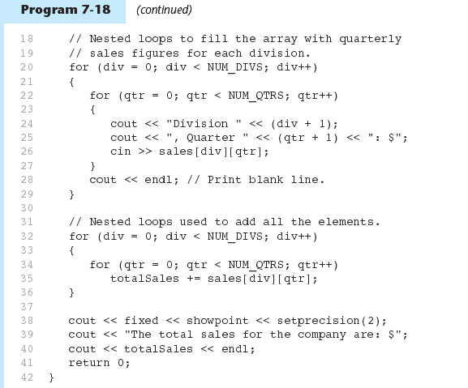
Two-Dimensional Array Representation - Example

Slide 63
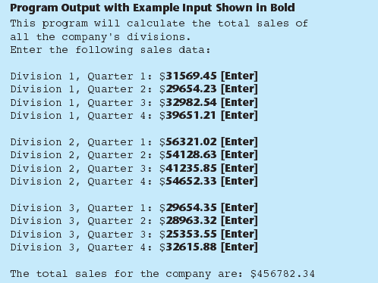
Two-Dimensional Array Representation - Example

Slide 64
2D Array Initialization
Two-dimensional arrays are initialized row-by-row:
const int ROWS = 2, COLS = 2;
int exams[ROWS][COLS] = { {84, 78},
  {92, 97} };
Can omit inner { }, some initial values in a row – array elements without initial values will be set to 0 or NULL
84 | 78
92 | 97

Slide 65
Two-Dimensional Array as Parameter, Argument
Use array name as argument in function call:
  getExams(exams, 2);
Use empty [] for row, size declarator for column in prototype, header:
const int COLS = 2;
// Prototype
void getExams(int [][COLS], int);
// Header
void getExams(int exams[][COLS], int rows)

Slide 66
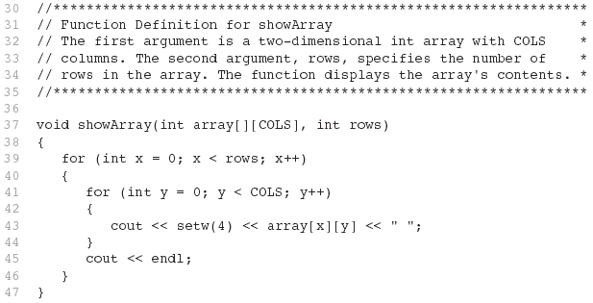
Example – The showArray Function

Slide 67
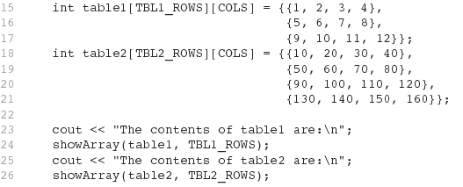
How showArray is Called

Slide 68
Summing All the Elements in a Two-Dimensional Array
Given the following definitions:
const int NUM_ROWS = 5; // Number of rows
const int NUM_COLS = 5; // Number of columns
int total = 0; // Accumulator
int numbers[NUM_ROWS][NUM_COLS] =
{{2, 7, 9, 6, 4},
{6, 1, 8, 9, 4},
{4, 3, 7, 2, 9},
{9, 9, 0, 3, 1},
{6, 2, 7, 4, 1}};

Slide 69
Summing All the Elements in a Two-Dimensional Array
// Sum the array elements.
for (int row = 0; row < NUM_ROWS; row++)
{
for (int col = 0; col < NUM_COLS; col++)
total += numbers[row][col];
}
// Display the sum.
cout << "The total is " << total << endl;

Slide 70
Summing the Rows of a Two-Dimensional Array
Given the following definitions:
const int NUM_STUDENTS = 3;
const int NUM_SCORES = 5;
double total; // Accumulator
double average; // To hold average scores
double scores[NUM_STUDENTS][NUM_SCORES] =
{{88, 97, 79, 86, 94},
{86, 91, 78, 79, 84},
{82, 73, 77, 82, 89}};

Slide 71
Summing the Rows of a Two-Dimensional Array
// Get each student's average score.
for (int row = 0; row < NUM_STUDENTS; row++)
{
// Set the accumulator.
total = 0;
// Sum a row.
for (int col = 0; col < NUM_SCORES; col++)
total += scores[row][col];
// Get the average
average = total / NUM_SCORES;
// Display the average.
cout << "Score average for student "
<< (row + 1) << " is " << average <<endl;
}

Slide 72
Summing the Columns of a Two-Dimensional Array
Given the following definitions:
const int NUM_STUDENTS = 3;
const int NUM_SCORES = 5;
double total; // Accumulator
double average; // To hold average scores
double scores[NUM_STUDENTS][NUM_SCORES] =
{{88, 97, 79, 86, 94},
{86, 91, 78, 79, 84},
{82, 73, 77, 82, 89}};

Slide 73
Summing the Columns of a Two-Dimensional Array
// Get the class average for each score.
for (int col = 0; col < NUM_SCORES; col++)
{
// Reset the accumulator.
total = 0;
// Sum a column
for (int row = 0; row < NUM_STUDENTS; row++)
total += scores[row][col];
// Get the average
average = total / NUM_STUDENTS;
// Display the class average.
cout << "Class average for test " << (col + 1)
<< " is " << average << endl;
}

Slide 74
Array of Strings
Use a two-dimensional array of characters as an array of strings:
const int NAMES = 3, SIZE = 10;
char students[NAMES][SIZE] =
  { "Ann", "Bill", "Cindy" };
Each row contains one string
Can use row subscript to reference the string in a particular row:
  cout << students[i];

Slide 75
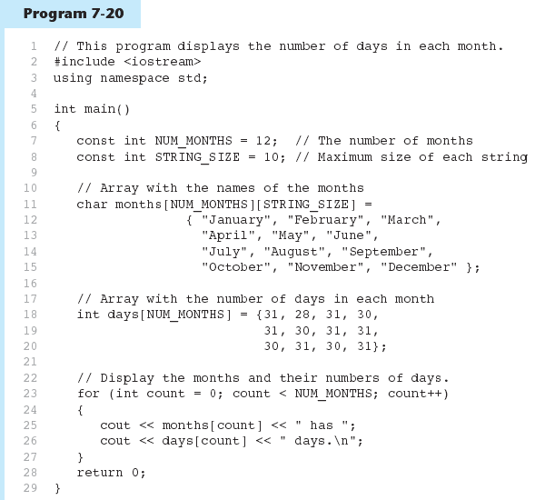
Array of Strings - example

Slide 76
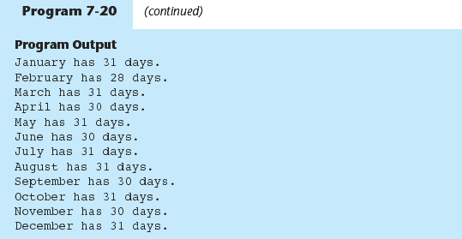
Array of Strings

Slide 77
Arrays with Three or More
Dimensions
Can define arrays with any number of dimensions:
  short rectSolid[2][3][5];
  double timeGrid[3][4][3][4];
When used as parameter, specify all except 1st dimension in prototype, heading:
  void getRectSolid(short [][3][5]);

Slide 78
In-Class Exercise
Define a two-dimensional array of int named grades. It should have 30 rows and 10 columns.
How many elements are in the following array?
  double sales[6][5];

Slide 79
In-Class Exercise
Define an array of strings to store the name of your friends in this class.
Initialize the array with 5 names.
Print the names.
Write a function to change the names in the array.
void changeName(char [][25], int size);

Slide 80
In-Class Exercise
Consider the following declarations:
  const int CAR_TYPES = 5;
  const int COLOR_TYPES = 6;
  double sales[CAR_TYPES][COLOR_TYPES];
How many elements does the array sales have?
What is the number of rows in the array sales?
What is the number of columns in the array sales?
Write a complete code to sum the sales by CAR_TYPES.
Write a complete code to sum the sales by COLOR_TYPES.

Slide 81
Write a complete program that stores the following number of medal collection for 5 countries into the 2-D array called medals.
Your program must have the following functions that do the following:
  Read the number of medal for each country from a keyboard and store them inside the medals array.
  Return total number of medals won by country 3.
  Return the largest number of medals won.
  Return the smallest number of medals won.
  Return the highest number of gold medal won.
  Return the total number of bronze medal won.
 | Gold | Silver | Bronze
Country 1 | 129 | 257 | 590
Country 2 | 120 | 279 | 394
Country 3 | 115 | 290 | 123
Country 4 | 98 | 209 | 112

